Slide 1
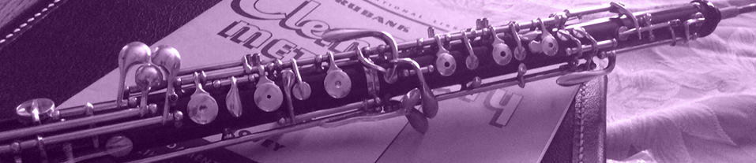
Oboe 101 Oboe advice for the non-oboe player
Karen E. Ballengee
FALL 2017

Slide 2
Background Information
An elementary school instrumental music teacher is expected to teach a variety of instruments. Some of these instruments might be outside the teacher’s area of expertise For example, the band director could be a trumpet player who is teaching beginning oboe players. This director may have had a woodwind methods class in college, but would not be an expert on that instrument. Yet, to first-year students and their parents, the band director is viewed as the musical expert. Unless the student is fortunate enough to have a private instructor, the band director is the resource for all things pertaining to the student’s instrument. This guide will give first-year band directors the resources to be able to start first-year students on the oboe. Included in this guide are equipment and music suggestions, basics for producing a tone, fingering explanations, and resources.

Slide 3


Learning Outcomes & Types of Questions
The participant will successfully compare and contrast music equipment and resources and select the most appropriate materials for their classroom.
The participant will successfully recall the basics of oboe assembly, maintenance, embouchure, and tone production and demonstrate for their students.
The participant will successfully recall the different types of fingerings, select the most appropriate fingering for the situation, and demonstrate the fingering for their students.
Job task
Goal-oriented procedural knowledge

Slide 4

Meet Dave.
What resources are out there?
This is Dave. It’s Dave’s first year as a band director at Westmore Elementary School and he has two students who will begin the oboe this year. Dave had a woodwind methods class in college, but he was a trombone major so he has a lot of questions about the oboe.
DIRECTIONS: Click the question clouds to find out more about the oboe.
What type of equipment should I recommend?
How do I get students started?
How does the fingering system work?
What type of music should I use?

Slide 5
Equipment
Student oboes are made of plastic and come without the extra keys found on professional model instruments. Plastic is recommended for beginners as it is more durable. There are many options available to rent or purchase an instrument.
DIRECTIONS: Click the question clouds to find out more about instruments and accessories.
What brand of instruments do I recommend t students?
What types of accessories will students need?
HOME

Slide 6
Instruments
These are some of the better models of student oboes and, as a result, they cost a little more. These instruments both use the modified conservatory system which is usually only available on intermediate instruments. The additional trill keys allow a smooth transition from note to note.
Additional Brands:
Bundy
Jupiter
Giardinelli
Larilee
Fox
Selmer 123FB
$2,539 (new)
Yamaha YOB-441
$2,852 (new)
Key of C
Resonite body
Modified conservatory system
Ab-Bb and left-hand C-D trills
Range to low Bb
Modified conservatory system
Semi-automatic octave keys
Covered keys
Trill keys: C# t D#, F# to G#, A# to B, B to C#, right C to D
ABS resin body
EQUIPMENT
HOME

Slide 7
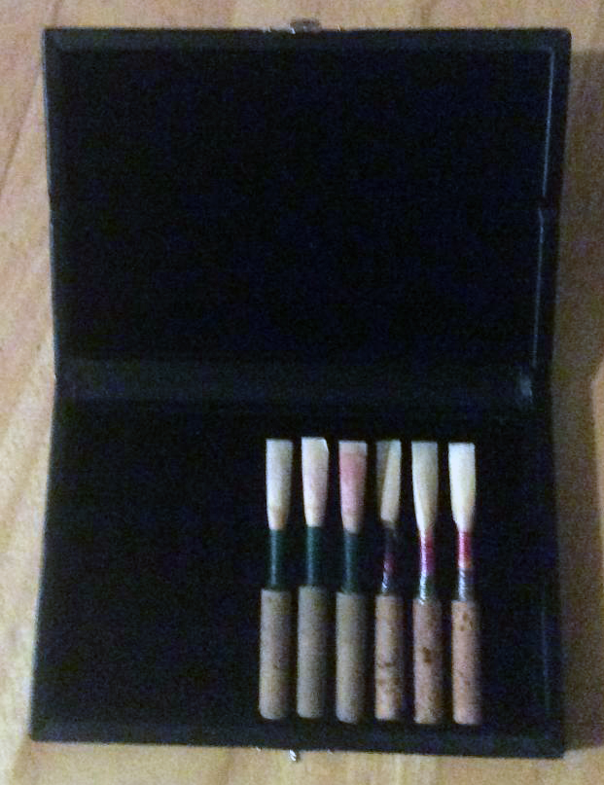
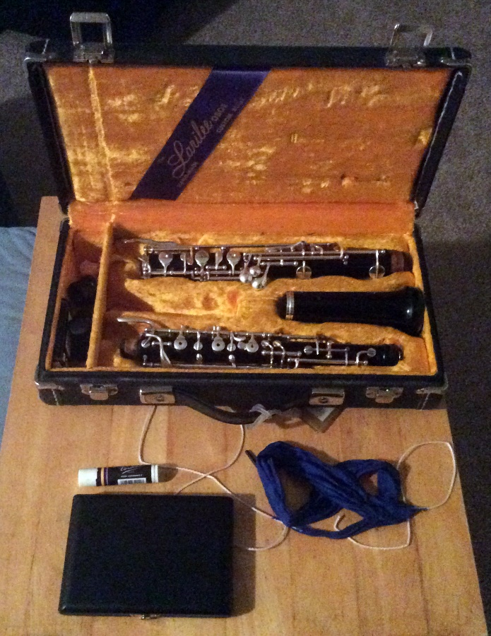
Accessories
Reeds
Most advanced oboe players make their own reeds, but pre-made reeds can be easily purchased. These reeds range in price from $8.00 to $24.00 for a single reed. Some suggested brands for beginners are:
Eastman
Emerald
Jones
Cork grease
Swab
EQUIPMENT
Reed case
HOME

Slide 8
Music
There are many band method books on the market that provide interactivity through Smart Music, DVDs, or CDs. These are the perfect books for today’s students who grew up with technology. There are also oboe-specific books that focus on the problems and pieces of the oboe. In addition to the method books generally used in schools, there are supplemental materials that give the students additional options for literature.
DIRECTIONS: Click the question cloud to find out more about books and music.
What kind of supplemental music is available?
What method book should I use?
HOME

Slide 9
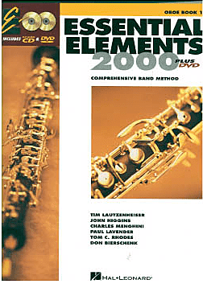
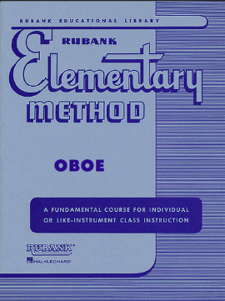
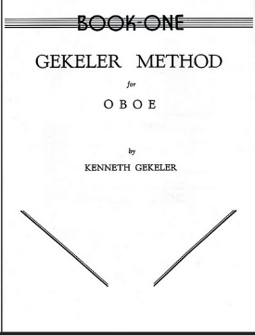
Method Books
Essential Elements 2000
Book 1
Rubank
Elementary Method
Geckler Oboe Method Book 1
This book is great because it can be used with Smart Music and the students have a choice of practicing with a DVD or CD. The layout is attractive and easy-to-read. The notes are introduced in an odd order and many new notes are introduced at once which could be a problem for young students.
This book is very basic and low-tech. Rubank is always the best way to learn scales and technique. Oboe fingerings have changed over the years, so there are some incorrect fingerings in this book. The book also advances at a rapid pace which might be too fast for younger students.
This is a more oboe-specific book and might be better used in a private lesson setting. The book has no interactive elements, but does offer oboe specific problems, exercises, and music.
MUSIC
HOME

Slide 10


Supplemental Music
From the Maryland Grade 1 list
Most state Music Educator Associations have a list of graded solos for each instrument. If your state does not have such a list, visit the state of Maryland’s. There are also books with a variety of solos. First year students would generally play a Grade 1 or 2 solo.
Title | Composer | Publisher
Minuet in G | Bach | Medici
Largo | Dvorak | Belwin
The Sway | Saint-Saens | Carl Fischer
Sentimental Lady | Weber | Belwin
Solo
Collections
MUSIC
HOME

Slide 11
Getting Started
How do I assemble the oboe?
The first couple of weeks of lesson instruction should be spent learning to care for the instrument and learning to produce a tone. Proper assembly and maintenance will keep the instrument out of the repair shop. Proper hand position and embouchure will get the students off to a good start.
How do you produce a tone on the oboe.
How do you care for and maintain an oboe?
HOME

Slide 12

Care and Maintenance
The oboe is quite easy to maintain. These instruments should be kept away from water and should be swabbed after each use.
STARTING
HOME

Slide 13
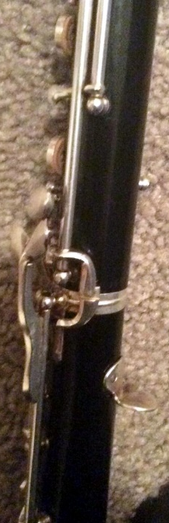
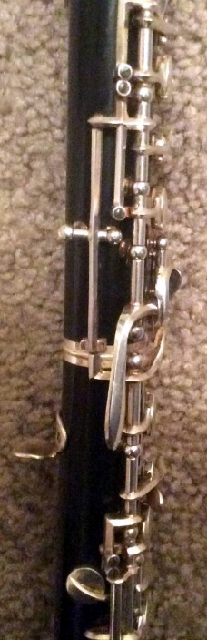
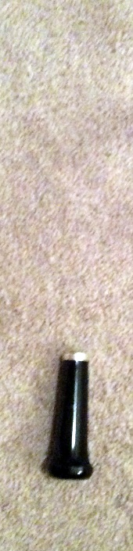
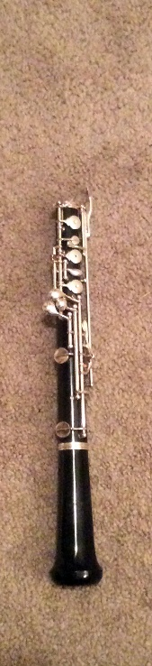
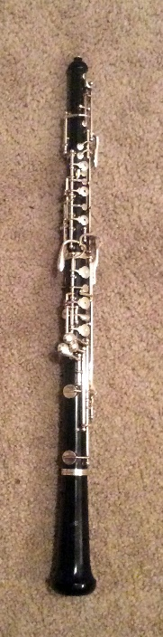
Assembling the Oboe
Bridge Keys
Assembly Order
The best way to assemble an oboe is to put it together from bottom to top.
Great care should be taken to line up both bridge keys though some instruments might play better with the bridge keys slightly misaligned.
STARTING
Left
Right
1
2
3
HOME

Slide 14
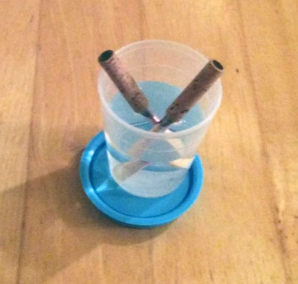
Producing a Tone
Hand position, tonguing, and embouchure are difficult topics to teach. Here are some basic principles. The resources provided provide further information for reinforcing these techniques and troubleshooting any problems.
Hand Position
Left hand on top
Right hand on the bottom
The right thumb sits below the thumb rest
The hands should form a C
Tonguing
The tongue doesn’t start note.
The tongue should release from the tip of the reed to make sound
Students can practice tonguing by using just the reed
Embouchure
Form an “O” with the lips
The teeth should not have contact with the reed
The bottom lip should make a cushion
Reeds should be soaked for 3-5 minutes before playing
STARTING
HOME

Slide 15
Fingerings
Most woodwind instruments have the same basic fingerings. The oboe is slightly different because it contains two octave keys. The oboe has alternate fingerings, but not as many as the clarinet.
DIRECTIONS: Click the question cloud to find out more about basic and alternate fingerings.
What are some alternate fingerings?
What are the basic fingerings?
HOME

Slide 16
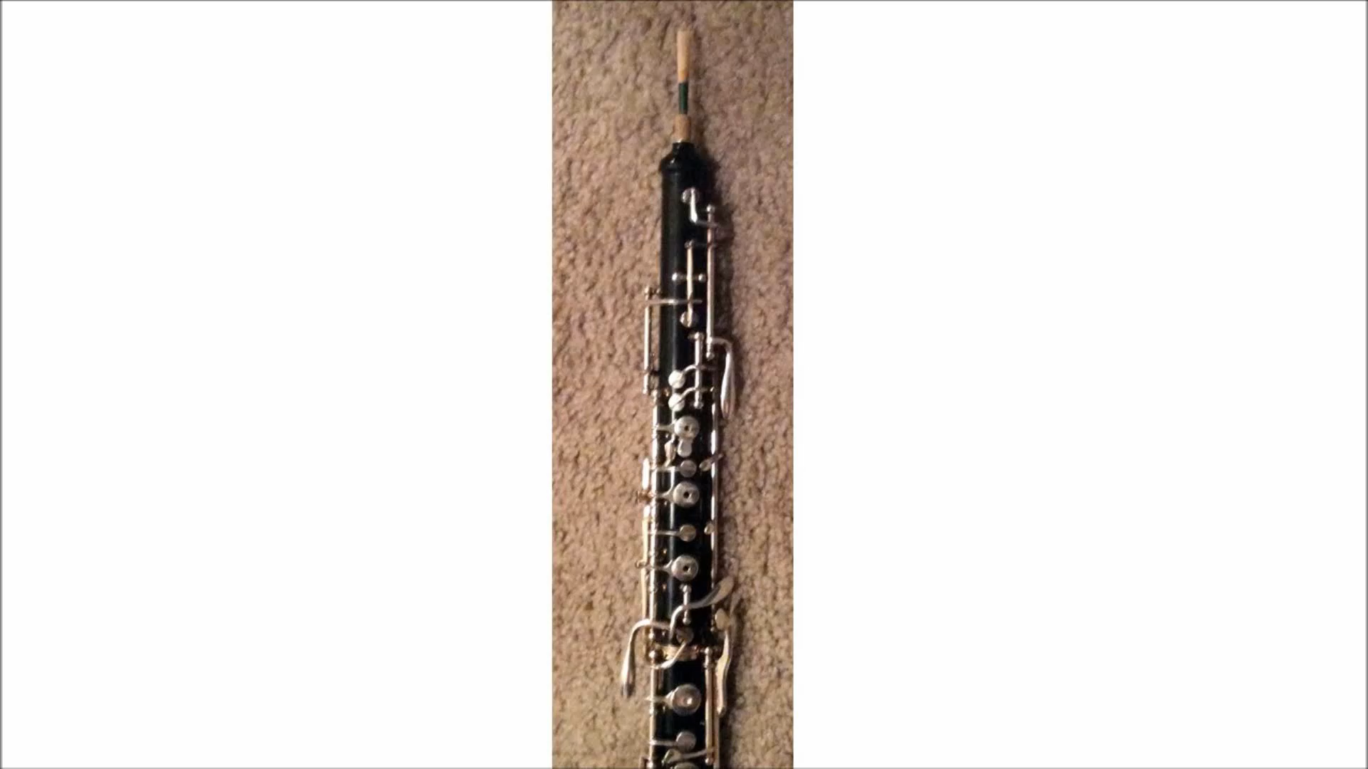
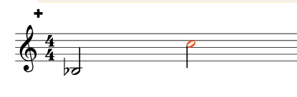
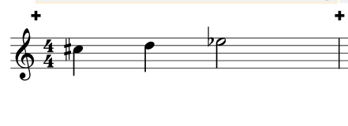
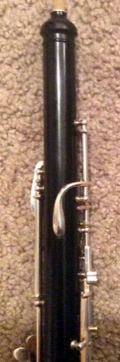
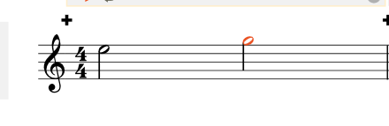
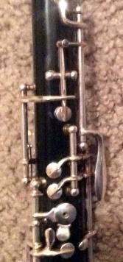
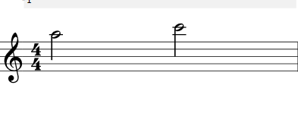
Basic Fingerings
1st Octave
The half hole method requires that only half the hole of the B key to be covered. The player should slide the finger instead of rolling the finger. There are several You Tube videos available to learn this method.
Notes requiring
half hole
Back View
1st octave key
Use left thumb
Notes using
1st octave key
Press Play button to see the half hole technique demonstrated.
Front View
When the second octave key is used, the first octave key should also be used
2nd octave key
Use left forefinger
Also use 1st octave key
FINGERINGS
Note using
2nd octave key
HOME

Slide 17
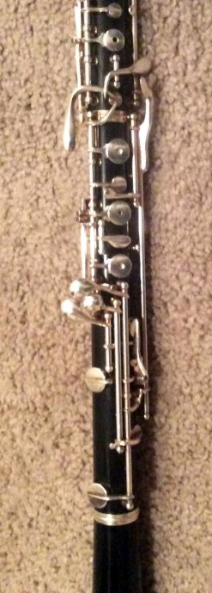
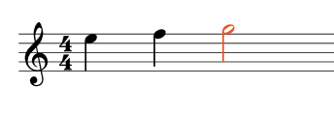
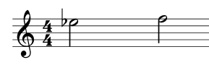
Alternate Fingerings
The only alternate fingering that first-year oboe students will need to know is the alternate F.
Regular F
This fingering works fine if your are playing in a scale pattern such as the example below.
Alternate F
In the example below, regular F won’t work because the player is required to slide the third finger of the right hand up which is almost impossible at a quick tempo. With alternate f, the player only needs to lift the middle finger of the right hand.
FINGERINGS
E
F
Eb
F
HOME

Slide 18
Resources
What are good resources for oboe?
Wow! That is a lot of information to remember. Dave is still a little confused about the oboe. Here are some resources that can help you and Dave teach your beginning oboe players.
DIRECTIONS: Click the question cloud to find out more about books, resources, and apps.
What are some good books on the oboe?
Are there apps for oboe?
FINGERINGS
HOME

Slide 19


Web Resources
This group is for professional and amateur double reed players. The IDRS holds conferences every year.
Weiner Music caters to woodwind players and is a great resource for oboe equipment and music.
Jeanne specializes in woodwind music.
RESOURCES
Clink the logos to visit the sites.
HOME

Slide 20


Books on Oboe
The Art of Oboe Playing
This book has a history of the oboe, tips on getting started and oboe specific exercises. It is perfect for oboe performers and anyone who teaches oboe.
Teaching Woodwinds
This book has information on all of the woodwinds. The oboe section information on embouchure, a fingering chart, and an extensive repertoire list.
RESOURCES
HOME

Slide 21

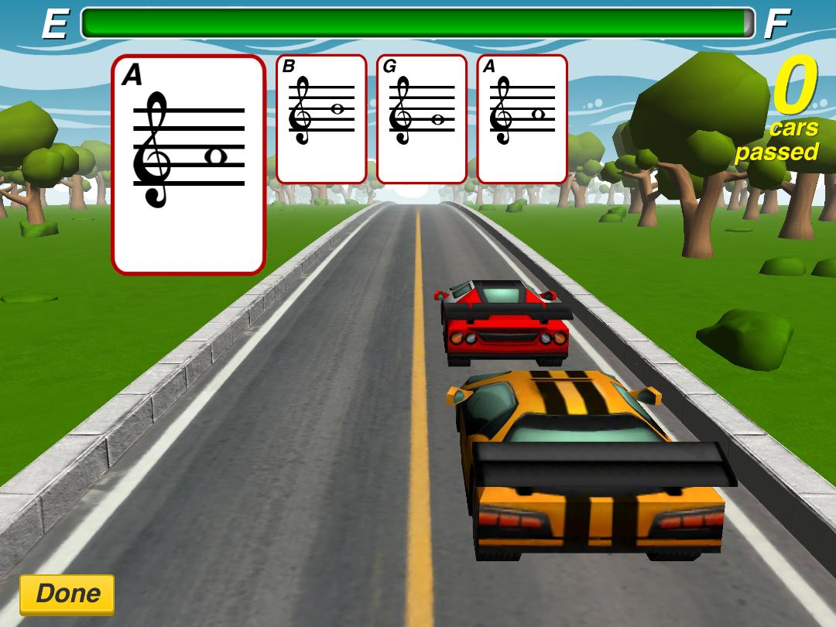
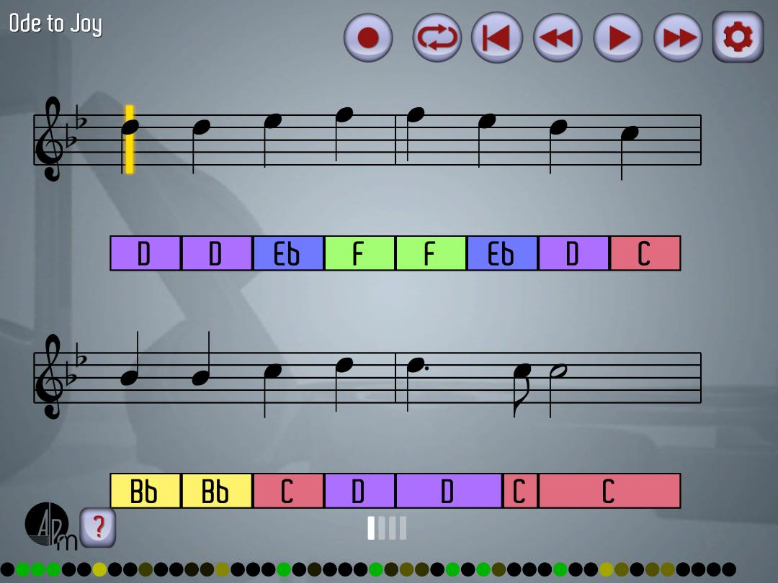
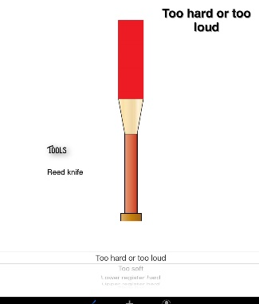
Oboe Apps
Oboe Racer
Oboe Play-Along
Oboe Reeds
This app is good for students to practice notes. A note shows up on the screen and the student must answer correctly to pass other cars.
This is an excellent app for music reading. The music appears on the screen and the student plays along.
This app shows the user where to adjust the reed to fix certain issues. This wouldn’t be a good app for a beginning student, but would be an excellent resource for a band director to trouble-shoot reed problems.
RESOURCES
HOME

Slide 22
References
Dietz, W., Kirkbride, J., Weiger, M., & Whittaker, C. (1998). Teaching woodwinds: A method and resource handbook for music educators. Schirmer.
Photo Credits
Jeanne webpage
International Double Reed Society webpage
Weiner Music Webpage
Oboe Racer app
Oboe Reed app
Oboe Play-along app

